Slide 1
FY and Q4 2024 Business Review
March 2025

Slide 2
DISCLAIMER
No statement in this document is intended to be nor may be construed as a profit forecast. Any statements made in this document which could be classed a “forward-looking” are based upon various assumptions, including management’s examination of historical operating trends, data contained in the Company’s records and other data available from third parties. Although the Company believes that these assumptions were reasonable when made, these assumptions are inherently subject to significant risks, uncertainties and contingencies. Forward-looking statements are not a guarantees of future performance. Risks, uncertainties, contingencies could cause the actual results of operations, financial condition and liquidity of the Company to differ materially from those results expressed or implied in the document by such forward-looking statements. No representation or warranty is made that any of these forward-looking statements or forecasts will come to pass or that any forecast result will be achieved. No reliance should be placed on any forward-looking statement.

Slide 3


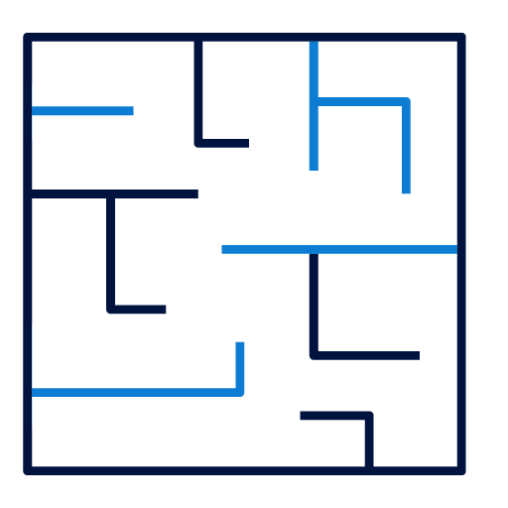





2024 FINANCIAL AND OPERATIONAL HIGHLIGHTS
Operational
Material progress on Private Equity and Real Estate; continued efforts to redeem assets in Goldilocks Fund
Strategic exits within Goldilocks Fund, coupled with AED 401 million reduction in liabilities
Healthy occupancy in Real Estate assets, with average occupancy of c.99% in Q4 2024
Financial
Goldilocks Fund net investment value closed year at AED 659m, following strategic exits and re-valuation of assets
Gross profit from commercial operations for FY24 totaled AED 11.6 million
Net loss for FY24 of AED 679.4m compared vs. AED 545.1m in FY23
Notes:
prl

Slide 4
RECAP: future eshraq
Under its refreshed strategy, Eshraq will have control of its destiny by focusing on directly-held Private Equity investments complemented by cash generation from minority equity stakes, Real Estate and prudent liquidity management.
Status Quo Eshraq
Future Eshraq
Real Estate, Private Equity and public equities
Focused regional Private Equity strategy
Indirect holdings
Direct holdings
Limited control
Significant control of investments
Less focus on cash generation
Cash generating assets

Slide 5
RECAP: Spotlight on strategic pillars
Core Business
Direct Private
Equity exposure
1
Sourcing & Screening
Transaction Structuring
Value Realization
1
Ensure quality deal flow
Optimize screening process
Strategic capital deployment
Attractive valuation
Value lever identification
Aligned incentives
Lever activation
Capable management
Exit planning
2
3
Complementary
yield-generating assets
2
Minority Equity Stakes
Real Estate
Capital Preservation
Stable dividend paying stocks
Protected minority stakes
Positive net operating yields after leverage
Low-risk approach
Effective cash management generating stable returns
Treasury management
3
Key operational enablers
People
Processes
Systems
Investing in skilled investment
professionals
Optimized organizational structure
Robust due diligence and investment committee processes
Governance and oversight
Enabling platforms (IR CRM, best-in-class market intelligence, secure data rooms, etc.)

Slide 6

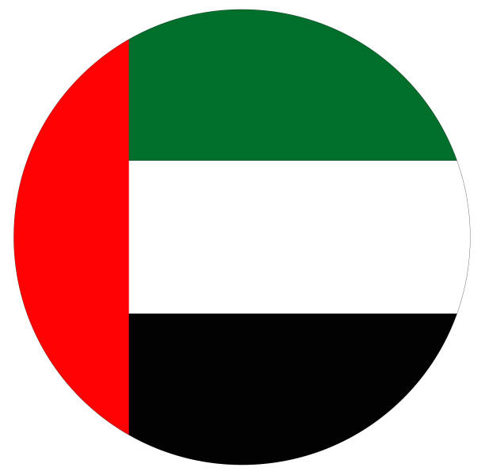

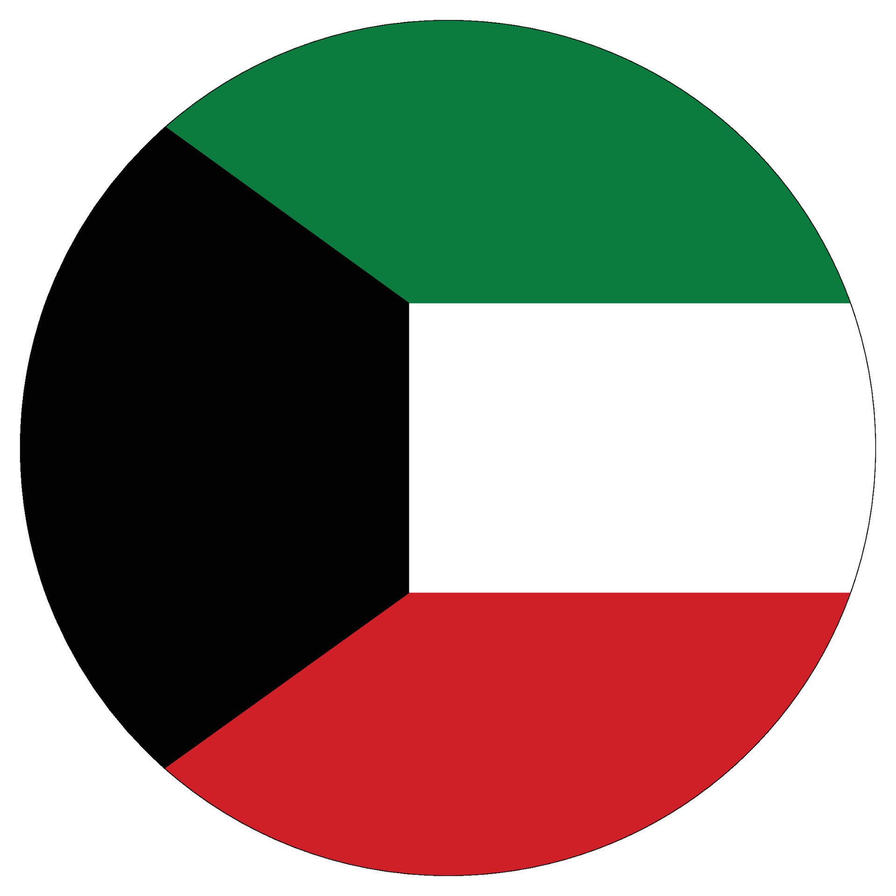














strategic shift to long-term growth through private equity
Eshraq targets investing into 1-2 high-growth businesses per-year, with a medium-term objective of yielding attractive cash flows as assets mature and become ready to exit.
Targeted activity
Progress in establishing Private Equity portfolio
Intended deal size range
Geographic focus
Execution target
USD 50-100m
1-2 deals/year
In line with transaction profile criteria
Eshraq is actively evaluating assets in a number of attractive and strategic sectors.
The Company expects to make further announcements on its progress during the coming months.
Eshraq continues to prioritize direct Private Equity investments, targeting high-growth potential companies to create long-term value.
Focusing on UAE and GCC
Targeted outcomes
Value creation
Investment period
Ownership
20-30%
asset growth
5-7 years
50-70%
direct equity stakes (control)
Ambitious growth targets set to justify targeted investments
Holding period for investments, driving value in target company
Targeting 50-70% direct equity stakes in fast-growing businesses
Real Estate Investments
Energy and Energy Services
Consumer
Islamic Finance
Infrastructure & Logistics
Technology
Healthcare
Food & Agriculture
Notes:
Prl (not Thalassa) – private equity

Slide 7
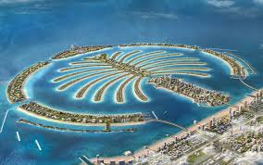
portfolio growth to be complemented by income-generating assets
In support of liquidity management to enable growth of the core Private Equity portfolio, Eshraq will selectively invest in assets that offer reliable cash flows that stabilise earnings and support its operations.
Progress in investing in income-generating Real Estate
1
Eshraq will continue to selectively invest in income generating minority equity stakes, fixed income assets and Real Estate to generate reliable cash flows and balance its investment portfolio.
Eshraq is one of four investors in the Ocean House luxury residential project on Palm Jumeirah, Dubai
95% of units sold, with sales value reaching c. AED 1.3 billion at end February 2025, with average selling price of > AED 5,200 per square foot.
2
This will be complementary to the core Private Equity portfolio, with a focus on stable dividend paying stocks and leveraging the existing Real Estate portfolio to deliver consistent returns through market cycles.
3
Management intends to maintain a more selective portfolio of income generating commercial and residential Real Estate assets, with a focus on stable, cash-generating properties that offer an attractive counterbalance to the dynamic nature of the core Private Equity portfolio.

Slide 8
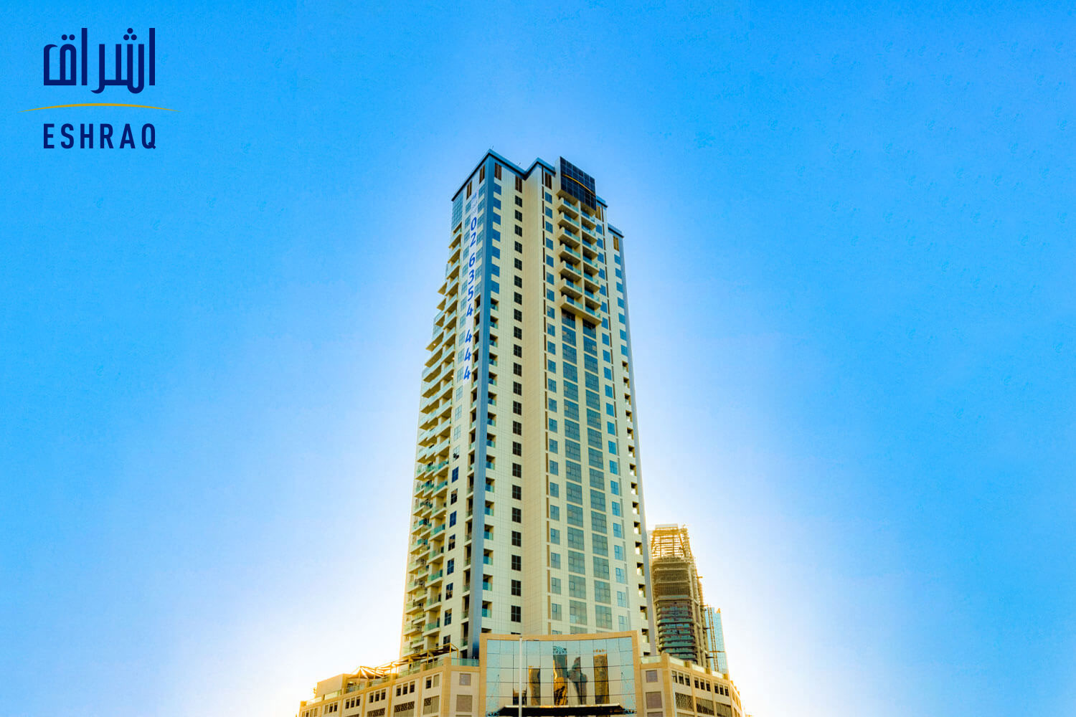
transition plans for legacy assets: real estate
Eshraq continues to work towards a transition plan for its existing Real Estate portfolio and has taken first steps in the creation of the Real Estate Development Fund, enabling the generation of stable rental revenue and development of future assets
Eshraq is executing a detailed multi-step plan to ensure optimal value creation and extraction from the Real Estate portfolio
Progress in transitioning legacy assets
Eshraq’s current portfolio of residential, commercial and tourism developments:
Marina Rise
Developed, income-generating asset
Prime location on Abu Dhabi’s Reem Island
Includes residential and commercial properties
Progress has been made towards identifying the future direction of Eshraq’s legacy Real Estate assets, with management in active discussions with potential partners concerning options for the development of its Abu Dhabi land bank.
Eshraq expects to make announcements in due course, as the Company progresses with its plans.
Real Estate assets may offer stable revenue and cash generation. The future of each asset is being evaluated accordingly.
Plot-specific feasibility studies are underway to inform the go-forward Real Estate strategy, on which announcements will be made in due course. Decisions will be made under the guiding principle of maximizing value from non-performing assets
4 strategic options for Real Estate assets
1
  Develop plots for subsequent lease
  (long-term income generation)
2
  Develop plots for subsequent sale
3
  Develop strategic plots, sell, swap or exit others
4
  Sell, swap or exit plots
  (immediate monetization)
Notes:
prl

Slide 9



Strategic investment in Shuaa capital Mandatory convertible bond
Eshraq’s investment in SHUAA Capital’s MCB supports its broader strategy to optimize its investments
Eshraq’s Board of Directors approved an investment of AED 50 million in SHUAA Capital’s Mandatory Convertible Bonds (MCB) offering, following the completion of analysis by an independent advisor.
Following conversion of the bonds into shares and Eshraq becoming a shareholder in SHUAA, Eshraq expects to be better positioned to advance its strategic objectives, including (but not limited to) the redemption of key assets managed by SHUAA, thereby safeguarding and enhancing long-term value for its shareholders.
It is the first of several steps Eshraq intends to take in support of its strategy to optimize the structure of its investment holdings.
Notes:
edit

Slide 10
Q4 2024 Financial Review

Slide 11
Q4 2024: KEY FINANCIAL INDICATORS
Q4 ‘24 gross profit from commercial operations of AED 2.9 million
Q4 ‘24 finance income +16.1% year-on-year
Q4 ’24 year-on-year net loss improved 17.7%
AED (‘000)
AED (‘000)
+16.1% YoY
AED (‘000)
+17.7% YoY
Q4 2024 financial highlights
Commercial Real Estate operations generated AED 4.2 million of revenue in Q4 2024, down 16.8% year-on-year due to a decline in rental income following the profitable sale of Real Estate assets in Dubai in 2023
Finance Income of AED 1.7 million in Q4 2024, up 16.1% versus Q4 2023
Net Loss improved 17.7% in Q4 2024 vs. Q4 2023, driven mainly by asset write-downs following re-valuation of holdings within Goldilocks Fund.
Total liabilities reduced by 6.4% since year-end 2023 to AED 153.4 million, as Eshraq continued to deleverage its balance sheet, with Goldilocks reducing its liabilities by AED 401 million during 2024
Notes:
Remove q4 2023 add q4 24 – prl

Slide 12
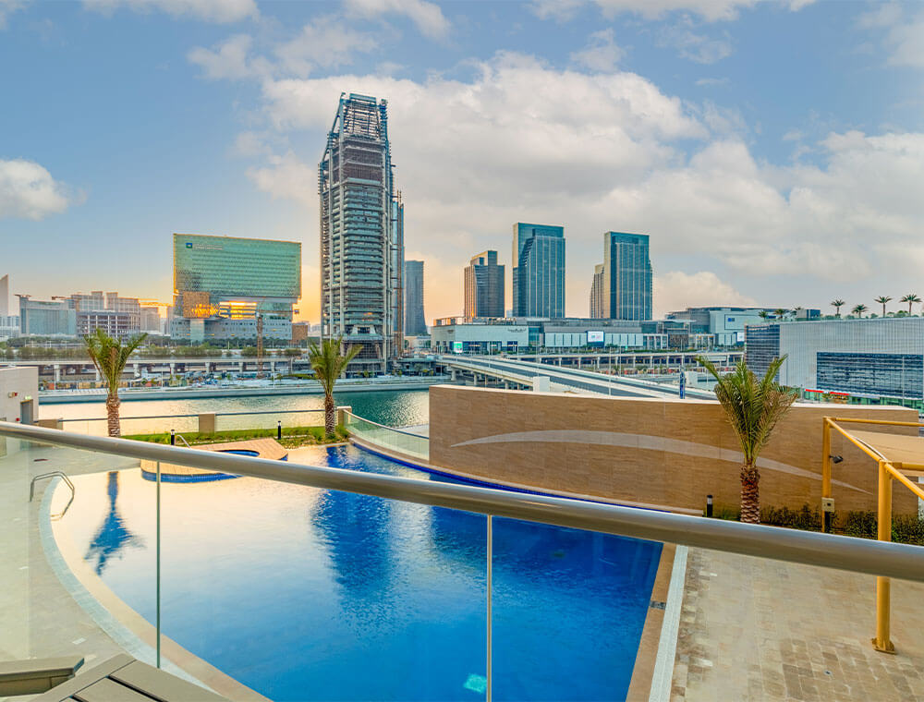
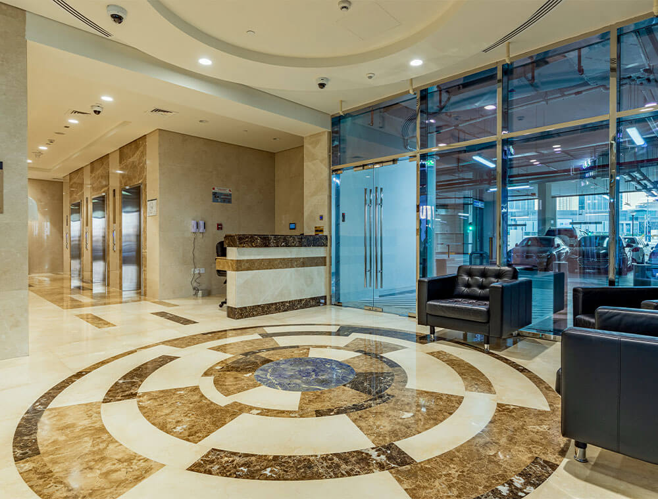

Q4 2024: REAL ESTATE PERFORMANCE
Real Estate assets Q4 2024 financial performance (AED ‘000)
Marina Rise | Q4 2023 | Q4 2024
Revenue | 3,476 | 3,802
Profit/(loss) | 2,204 | 2,520
Q4 2024 Real Estate financial and strategic highlights
Commercial Real Estate operations generated AED 16.3 million of revenue in 2024
Gross profit from commercial operations reached AED 11.6 million in 2024
Healthy occupancy, with average Real Estate occupancy increasing to c.99% in Q4 2024
Notes:
Tbc – commercial ops

Slide 13
Q4 2024: GOLDILOCKS FUND PERFORMANCE
Fund’s performance¹ in Q4 2024 improved following strategic exits from certain investment positions
Q4 2024 Goldilocks investment breakdown - top three holdings
AED (‘000)
Investment | % of portfolio Q4 2024* | % of portfolio Q3 2024** | QoQ
Thalassa Investments | 53.9% | 50.2% | 3.3%
NCM Investment Company² | 26.6% | 35.7% | -8.9%
Islamic Arabic Insurance Co (Salama) | 11.5% | 7.5% | -3.8%
* Holdings as at 31 December 2024. ** Holdings as at 30 September 2024.
Goldilocks Q4 2024 financial and strategic highlights
Eshraq is engaging with SHUAA Capital to redeem assets in the Goldilocks Fund, aiming to gain full control over its holdings and investment decisions, and is committed to concluding the process as soon as possible
Goldilocks Fund underlying net investment value of
AED 659 million in Q4 2024
Liabilities reduced by AED 401 million in the twelve-month period to AED 108 million
12 investments in the portfolio with a carrying value as at 31 December 2024
Fund net performance as of 31 December 2024
NCM Investment Company holdings includes NCM Financial UK Ltd
Notes:
tbc

Slide 14
GOLDILOCKS FUND VALUTION OF AED 659 MILLION IN Q4 2024
Reduction in the number of investments within the Goldilocks Fund from 19 in FY 2023 to 12 in Q4 2024.
Goldilocks Fund valuation movement from FY 2023 to Q4 2024
19 Investments
14 Investments
15
Investments
12
Investments
AED million
Change in value
Overview
Total underlying net investment value was AED 659 million at the end of Q4 2024, compared to AED 1.33 billion at the end of 2023, resulting from strategic exists from certain holdings as well as the re-valuation of assets.
Goldilocks reduced liabilities by AED 401 million in the twelve-month period.
The reduction in the investment value was the result of either a partial or full exit from certain investment positions within the Fund, with Goldilocks having 12 investments within its portfolio in Q4 2024 (versus 19 at Q4 2023).
Notes:
Tbc + q4

Slide 15


Ongoing review of Goldilocks fund valuation
Third-party legal and financial advisors appointed to conduct a forensic review of the management and valuation practices of the Goldilocks Fund
As previously announced, Eshraq has instructed third-party legal and financial advisors to conduct a forensic review of the management and valuation practices of the Goldilocks Fund, of which the findings and required corrective actions will be announced in due course.
Eshraq has expressed concerns regarding the valuation of the Goldilocks Fund.
The Company is of the opinion that the Fund Manager has failed to maintain consistency in the methodology applied for the valuation of assets under management, which resulted in significant unexplainable discrepancies in the reported Net Asset Value (“NAV”) of the Fund.
Eshraq relies on the valuation prepared by the Fund manager and consequently reported a sharp decline in the value of the Fund for 31 December 2024 compared to the valuation carried out by the Fund Manager for 30 September 2024.
The change in valuation methodology has forced Eshraq to reflect the decline in the Fund’s value in the final quarter of its financial statements.
The Board has commissioned a forensic review and will take all necessary corrective actions to protect and enhance shareholder value following conclusion of the investigation.
Notes:
edit

Slide 16
SUMMARY OF HISTORICAL FINANCIAL PERFORMANCE
 | Q42024 | Q42023 | FY2024 | FY2023 | FY2022 | FY2021
Revenue from commercial operations | 4,189 | 5,034 | 16,331 | 31,612 | 41,015 | 26,216
Direct Costs | (1,263) | (1,920) | (4,704) | (11,163) | (15,861) | (12,825)
Gross profit from commercial operations | 2,926 | 3,114 | 11,627 | 20,449 | 25,154 | 13,391
Net finance income | (650) | (2,395) | (1,467) | (9,593) | (907) | 7,862
Dividend income | - | - | - | 416 | 4,294 | 11,712
Change in investment FVTPL | 384,503 | (491,675) | (681,171) | (543,751) | 541,760 | 33,496
(Loss)/ income from investments | (384,503) | (491,675) | (681,171) | (543,335) | 546,436 | 46,089
Total operating income | (382,227) | (490,956) | (671,011) | (532,479) | 570,683 | 67,342
G&A and S&M expenses | (9,019) | (9,647) | (16,062) | (24,086) | (31,930) | (20,111)
Gain / Loss on valuation of IP | 8,066 | (1,600) | 8,066 | 958 | 50,510 | (9,110)
Gain / Loss on sale of Assets held for sale | - | 38,533 | - | 10,459 | - | -
Profit / (Loss) after tax for the period | (383,567) | (463,661) | (678,373) | (545,101) | 589,790 | 38,429
Total Assets | 1,613,916 | 2,276,674 | 1,613,916 | 2,276,674 | 3,019,773 | 1,688,819
Total Equity | 1,460,340 | 2,112,781 | 1,460,340 | 2,112,781 | 2,703,665 | 1,363,255
Book value per share (fils) | 54.38 | 78.68 | 54.38 | 74.91 | 95.86 | 58.63
Diluted earnings / (loss) per share (fils) | (14.28) | (17.09) | (25.30) | (20.08) | 30.11 | 1.68
Notes:
q4

Slide 17
Thank you
Media Enquiries Investor Enquiries
Teneo IR
Eshraq@teneo.com IR@eshraquae.com

