Slide 1
Q1 2025 Business Review
May 2025​

Slide 2
DISCLAIMER
No statement in this document is intended to be nor may be construed as a profit forecast. Any statements made in this document which could be classed a “forward-looking” are based upon various assumptions, including management’s examination of historical operating trends, data contained in the Company’s records and other data available from third parties. Although the Company believes that these assumptions were reasonable when made, these assumptions are inherently subject to significant risks, uncertainties and contingencies. Forward-looking statements are not a guarantees of future performance. Risks, uncertainties, contingencies could cause the actual results of operations, financial condition and liquidity of the Company to differ materially from those results expressed or implied in the document by such forward-looking statements. No representation or warranty is made that any of these forward-looking statements or forecasts will come to pass or that any forecast result will be achieved. No reliance should be placed on any forward-looking statement.

Slide 3


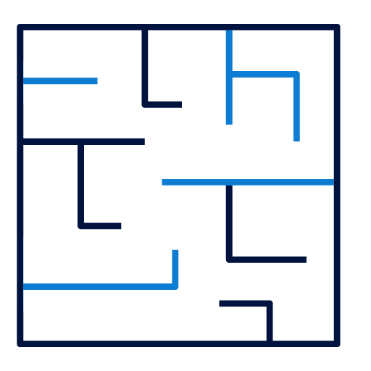




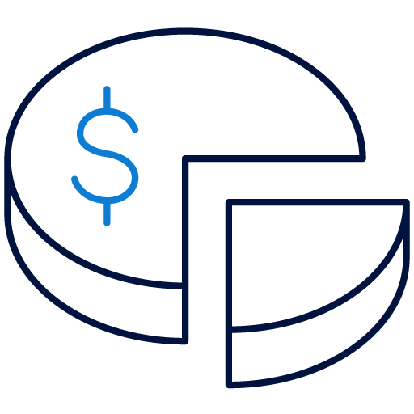
Q1 2025 FINANCIAL AND OPERATIONAL HIGHLIGHTS
Operational
Progress on Private Equity and Real Estate; continued efforts to redeem assets in Goldilocks Fund
Strategic exits within Goldilocks Fund, coupled with AED 2 million reduction in liabilities
Healthy occupancy in Real Estate assets, with average occupancy of
c.98% in Q1 2025
Financial
Goldilocks Fund net investment value of AED 647.77 million, following strategic exits and re-valuation of assets over last 12 months
Gross profit from commercial operations of AED 2.77 million in Q1 2025 vs. AED 2.92m in Q1 2024
Significant improvement in net loss, reaching AED (27.03) m in Q1 2025 vs. AED (306.05)m in Q1 2024
Notes:
prl

Slide 4
RECAP: future eshraq
Under its refreshed strategy, Eshraq will have control of its destiny by focusing on directly-held Private Equity investments complemented by cash generation from minority equity stakes, Real Estate and prudent liquidity management.
Status Quo Eshraq
Future Eshraq
Real Estate, Private Equity and public equities
Focused regional Private Equity strategy
Indirect holdings
Direct holdings
Limited control
Significant control of investments
Less focus on cash generation
Cash generating assets

Slide 5
RECAP: Spotlight on strategic pillars
Core Business
Direct Private
Equity exposure
1
Sourcing & Screening
Transaction Structuring
Value Realization
1
Ensure quality deal flow
Optimize screening process
Strategic capital deployment
Attractive valuation
Value lever identification
Aligned incentives
Lever activation
Capable management
Exit planning
2
3
Complementary
yield-generating assets
2
Minority Equity Stakes
Real Estate
Capital Preservation
Stable dividend paying stocks
Protected minority stakes
Positive net operating yields after leverage
Low-risk approach
Effective cash management generating stable returns
Treasury management
3
Key operational enablers
People
Processes
Systems
Investing in skilled investment
professionals
Optimized organizational structure
Robust due diligence and investment committee processes
Governance and oversight
Enabling platforms (IR CRM, best-in-class market intelligence, secure data rooms, etc.)

Slide 6

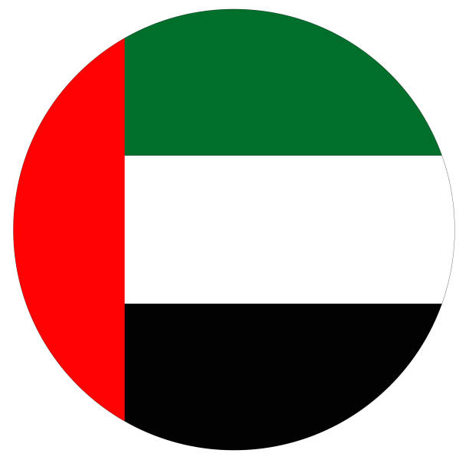

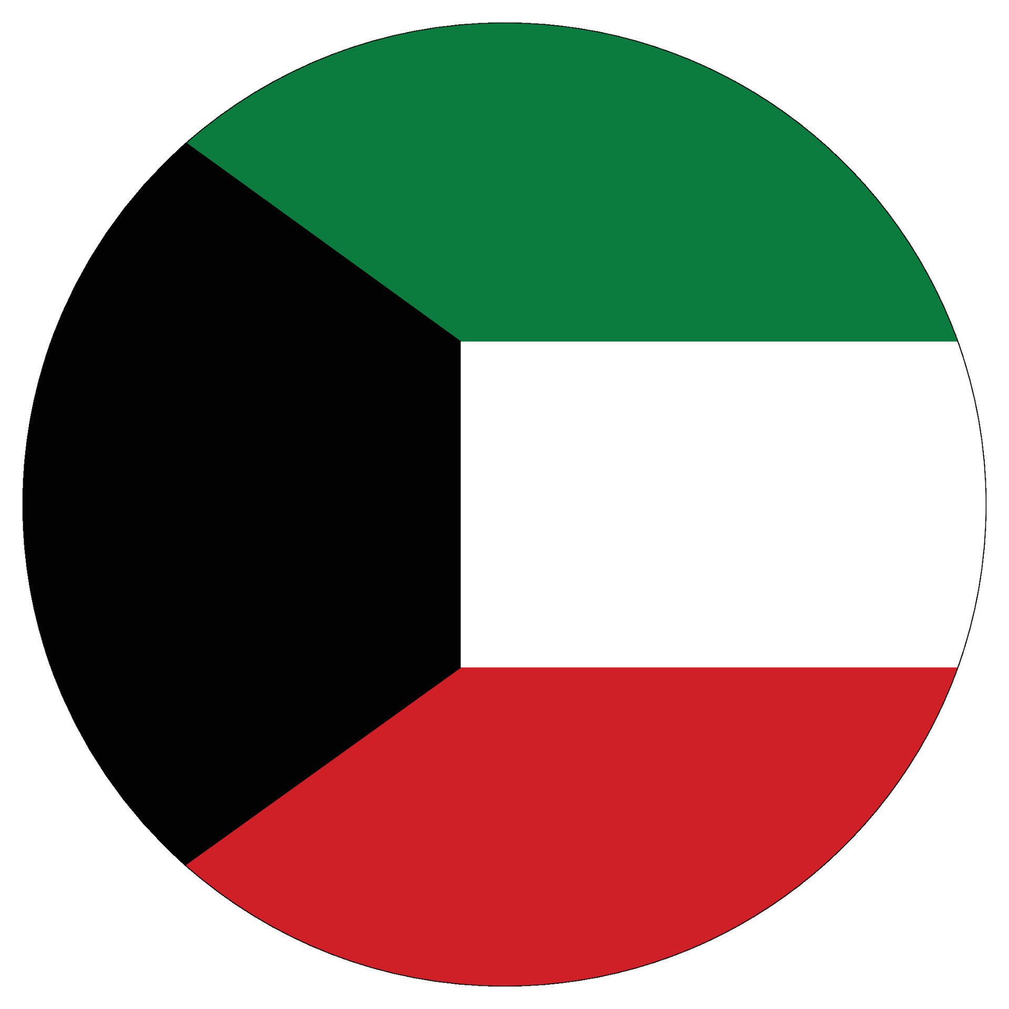
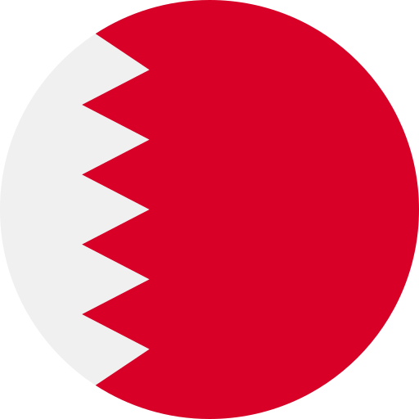

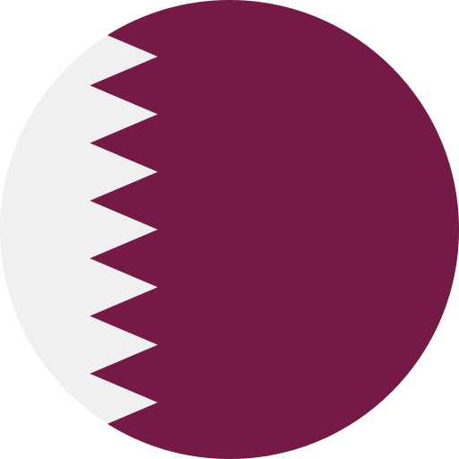
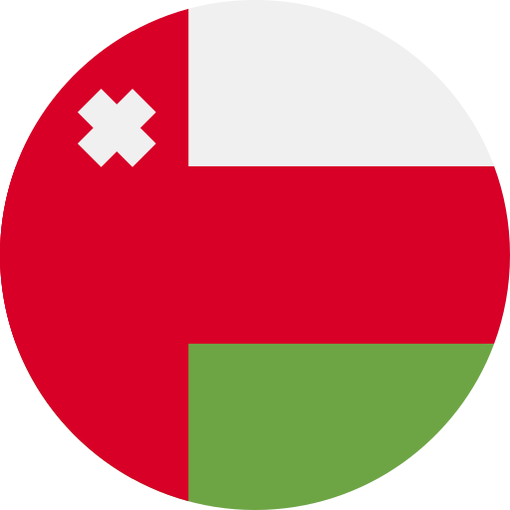










strategic shift to long-term growth through private equity
Eshraq targets investing into 1-2 high-growth businesses per-year, with a medium-term objective of yielding attractive cash flows as assets mature and become ready to exit.
Targeted activity
Progress in establishing Private Equity portfolio
Intended deal size range
Geographic focus
Execution target
USD 50-100m
1-2 deals/year
In line with transaction profile criteria
Eshraq is actively evaluating assets in a number of attractive and strategic sectors.
The Company expects to make further announcements on its progress during the coming months.
Eshraq continues to prioritize direct Private Equity investments, targeting high-growth potential companies to create long-term value.
Focusing on UAE and GCC
Targeted outcomes
Value creation
Investment period
Ownership
20-30%
asset growth
5-7 years
50-70%
direct equity stakes (control)
Ambitious growth targets set to justify targeted investments
Holding period for investments, driving value in target company
Targeting 50-70% direct equity stakes in fast-growing businesses
Real Estate Investments
Energy and Energy Services
Consumer
Islamic Finance
Infrastructure & Logistics
Technology
Healthcare
Food & Agriculture
Notes:
Prl (not Thalassa) – private equity

Slide 7
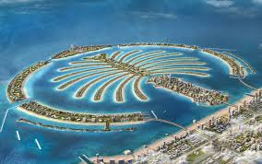
portfolio growth to be complemented by income-generating assets
In support of liquidity management to enable growth of the core Private Equity portfolio, Eshraq will selectively invest in assets that offer reliable cash flows that stabilise earnings and support its operations.
Progress in investing in income-generating Real Estate
1
Eshraq will continue to selectively invest in income generating minority equity stakes, fixed income assets and Real Estate to generate reliable cash flows and balance its investment portfolio.
Eshraq is one of four investors in the Ocean House luxury residential project on Palm Jumeirah, Dubai
95% of units sold, with sales value reaching c. AED 1.28 billion at end March 2025, with average selling price of > AED 5,200 per square foot.
2
This will be complementary to the core Private Equity portfolio, with a focus on stable dividend paying stocks and leveraging the existing Real Estate portfolio to deliver consistent returns through market cycles.
3
Management intends to maintain a more selective portfolio of income generating commercial and residential Real Estate assets, with a focus on stable, cash-generating properties that offer an attractive counterbalance to the dynamic nature of the core Private Equity portfolio.

Slide 8
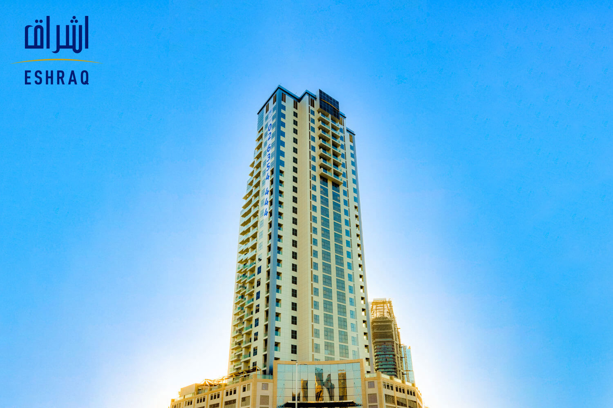
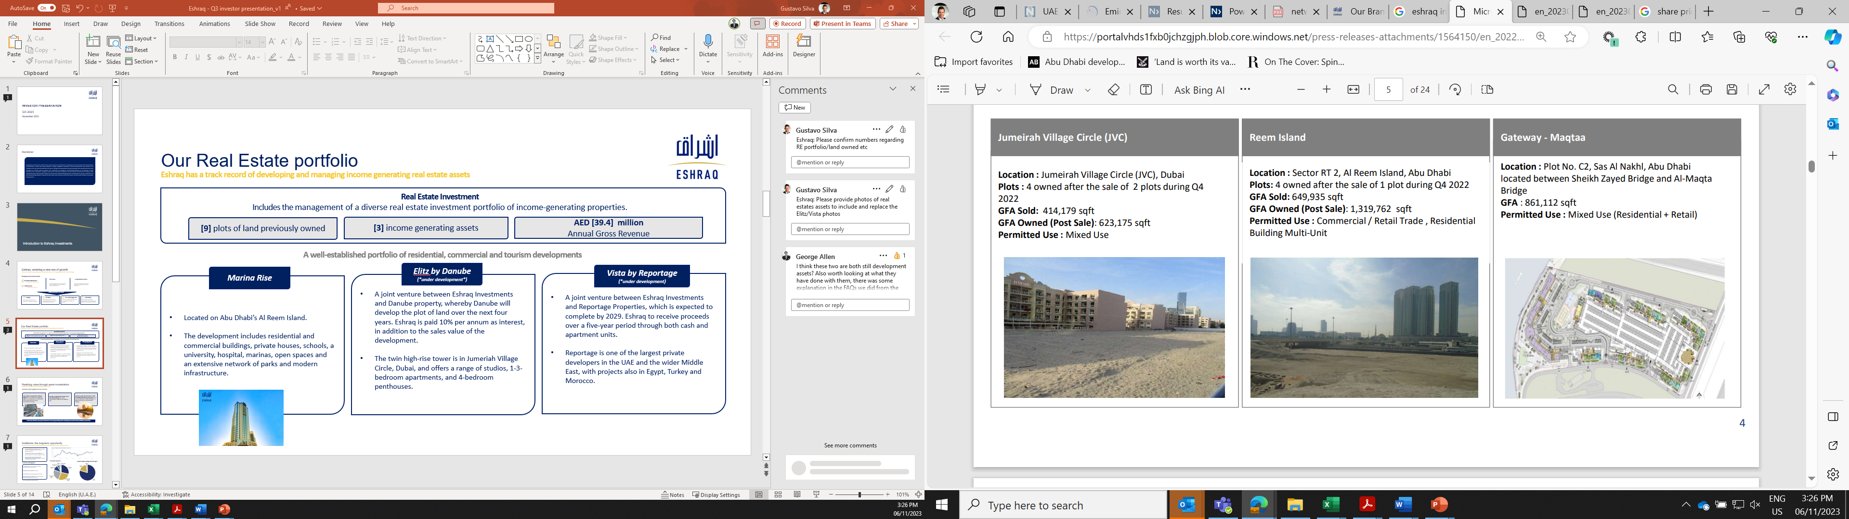
transition plans for real estate ASSETS
Continued work towards transition of Real Estate portfolio and first steps in the creation of the Real Estate Development Fund, enabling generation of stable rental revenue and development of future assets.
Eshraq is executing a multi-step plan to ensure optimal value creation from the Real Estate portfolio
Marina Rise (developed and income-generating)
Developed, income-generating asset
Prime location on Abu Dhabi’s Reem Island
Includes residential and commercial properties
Recent progress
Transition of legacy real estate portfolio is progressing
Several development partnerships and opportunities for the Abu Dhabi land bank are close to being confirmed, with announcements to be made in due course.
Elitz by Danube (under development)
Development JV between Eshraq and Danube
Twin high-rise residential towers in Jumeirah Village Circle (Dubai)
Vista by Reportage (under development)
Development JV between Eshraq and Reportage
Strategic early settlement of payment plan received in Q4 2024
Four strategic options for assets
Develop plots for subsequent rental income | Develop plots for subsequent sale
Develop strategic plots, sell, swap or exit others | Sell, swap or exit plots (immediate monetization)
Ocean House (developed and income-generating)
Developed, luxury income-generating residential project
95% of units sold in Q4 2024
Reem Island & Sas Al Nakhl Plots (x5) (ready for sale or development)
Notes:
prl

Slide 9



Strategic investment in Shuaa capital Mandatory convertible bond
Eshraq’s investment in SHUAA Capital’s MCB supports its broader strategy to optimize its investments.
Eshraq’s Board of Directors approved an investment of AED 50 million in SHUAA Capital’s Mandatory Convertible Bonds (MCB) offering, following the completion of analysis by an independent advisor.
Following conversion of the bonds into shares and Eshraq becoming a shareholder in SHUAA, Eshraq expects to be better positioned to advance its strategic objectives, including (but not limited to) the redemption of key assets managed by SHUAA, thereby safeguarding and enhancing long-term value for its shareholders.
It is the first of several steps Eshraq will take in support of its strategy to optimize the structure of its investment holdings.
Notes:
edit

Slide 10
Q1 2025 Financial Review

Slide 11
Q1 2025: KEY FINANCIAL HIGHLIGHTS
Gross profit from commercial operations totaled AED 2.77 million in Q1 2025, down 5.24% YoY
Finance income grew 4.18% YoY to AED 1.87 million in Q1 2025
Net loss narrowed by 91.15% YoY to AED (27.03) million
in Q1 2025
AED (‘000)
AED (‘000)
+4.18% YoY
AED (‘000)
+91.15% YoY
Q1 2025 financial highlights
Revenue from Commercial Real Estate operations reached AED 3.93 million in Q1 2025, down 2.96% YoY as the Nuran Management agreement ended in January 2025.
Finance Income reached AED 1.87 million in Q1 2025, up 4.18% versus Q1 2024
Net loss narrowed significantly, improving by 91.95% YoY in Q1 2025 vs. Q1 2024, driven by strategic exits from holdings within the Goldilocks Fund
Total liabilities stood at AED 143.52 million in Q1 2025, a 12.1% reduction compared to AED 160.88 million in Q1 2024 mainly driven by a continued reduction in bank borrowings and strategic exits from holdings within the Goldilocks Fund
Notes:
Remove q4 2023 add q4 24 – prl

Slide 12
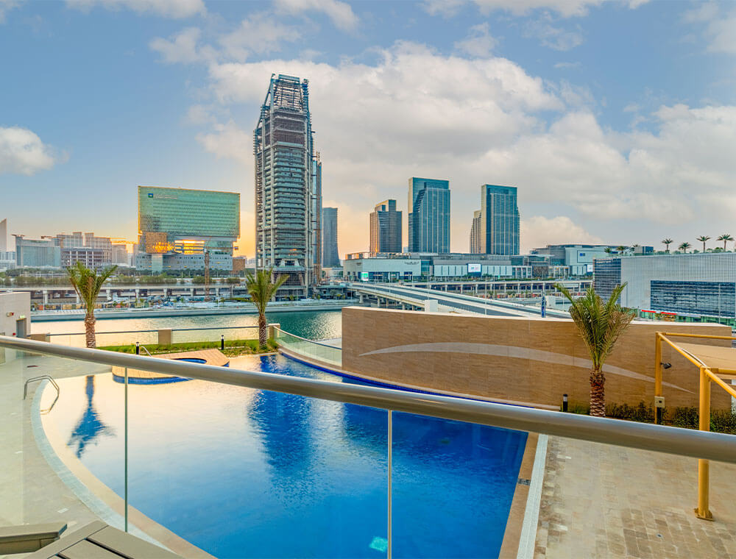
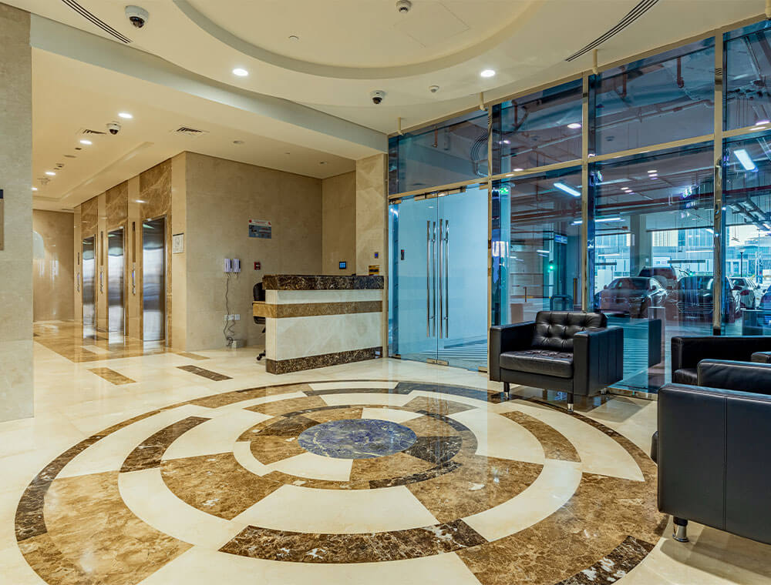

Q1 2025: REAL ESTATE PERFORMANCE
Real Estate assets Q1 2025 financial performance (AED ‘000)
Marina Rise | Q1 2024 | Q1 2025
Revenue | 3,745 | 3,865
EBIT | 2,751 | 2,710
Q1 2025 Real Estate financial and strategic highlights
Commercial Real Estate operations generated AED 3.93 million of revenue in Q1 2025
Gross profit from commercial operations reached AED 2.77 million in Q1 2025
Healthy occupancy, with average Real Estate occupancy increasing to c.98% in Q1 2025
Notes:
Tbc – commercial ops

Slide 13
Q1 2025: GOLDILOCKS FUND PERFORMANCE
Fund’s performance¹ in Q1 2025 reached AED 648 million following strategic exits from certain investment positions
Q1 2025 Goldilocks investment breakdown - top three holdings
AED (‘000)
Investment | % of portfolio Q1 2025* | % of portfolio Q4 2024** | QoQ
Thalassa Investments | 51.6% | 53.9% | (2.3%)
NCM Investment Company² | 35.0% | 26.6% | 8.4%
Islamic Arabic Insurance Co (Salama) | 7.5% | 11.5% | (4.0%)
* Holdings as at 31 March 2025. ** Holdings as at 31st December 2024.
Goldilocks Q1 2025 financial and strategic highlights
Eshraq is engaging with SHUAA Capital to redeem assets in the Goldilocks Fund, aiming to gain full control over its holdings and investment decisions, and is committed to concluding the process as soon as possible
Goldilocks Fund underlying net investment value of
AED 647.77 million in Q1 2025
Liabilities reduced by AED 2 million in Q1 2025 to
AED 107 million
12 investments within the portfolio as at 31 March 2025
Fund net performance as of 31 March 2025
NCM Investment Company holdings includes NCM Financial UK Ltd
Notes:
tbc

Slide 14
GOLDILOCKS FUND VALUTION OF AED 648 MILLION IN Q1 2025
Reduction in the number of investments within the Goldilocks Fund from 14 in Q1 2024 to 12 in Q1 2025.
Goldilocks Fund valuation movement from FY 2023 to Q1 2025
AED million
19 Investments
14 Investments
15
Investments
12
Investments
12
Investments
12
Investments
Change in value
Overview
Total underlying net investment value was AED 647.77 million at the end of Q1 2025, compared to AED 1.04 billion at the end of Q1 2024, resulting from strategic exists from certain holdings as well as the re-valuation of assets.
Goldilocks reduced liabilities by AED 2 million in Q1 2025.
The reduction in the investment value was the result of either a partial or full exit from certain investment positions within the Fund, with Goldilocks having 12 investments within its portfolio in Q1 2025 (versus 14 at Q1 2024).
Notes:
Tbc + q4

Slide 15
SUMMARY OF HISTORICAL FINANCIAL PERFORMANCE
 | Q1 2025 | Q1 2024 | FY2024 | FY2023 | FY2022 | FY2021
Revenue from commercial operations | 3,930 | 4,050 | 16,331 | 31,612 | 41,015 | 26,216
Direct Costs | (1,165) | (1,132) | (4,704) | (11,163) | (15,861) | (12,825)
Gross profit from commercial operations | 2,765 | 2,918 | 11,627 | 20,449 | 25,154 | 13,391
Net finance income | (244) | (677) | (1,467) | (9,593) | (907) | 7,862
Dividend income | 20 | - | - | 416 | 4,294 | 11,712
Change in investment FVTPL | (26,103) | (305,394) | (681,171) | (543,751) | 541,760 | 33,496
(Loss)/ income from investments | (26,083) | (305,394) | (681,171) | (543,335) | 546,436 | 46,089
Total operating income | (23,562) | (303,153) | (671,011) | (532,479) | 570,683 | 67,342
G&A and S&M expenses | (3,527) | (2,909) | (16,062) | (24,086) | (31,930) | (20,111)
Gain / Loss on valuation of IP | - | - | 8,066 | 958 | 50,510 | (9,110)
Gain / Loss on sale of Assets held for sale | - | - | - | 10,459 | - | -
Profit / (Loss) after tax for the period | (27,084) | (306,051) | (678,373) | (545,101) | 589,790 | 38,429
Total Assets | 1,576,843 | 1,967,566 | 1,613,916 | 2,276,674 | 3,019,773 | 1,688,819
Total Equity | 1,433,325 | 1,806,691 | 1,460,340 | 2,112,781 | 2,703,665 | 1,363,255
Book value per share (fils) | 53.38 | 64.06 | 54.38 | 74.91 | 95.86 | 58.63
Diluted earnings / (loss) per share (fils) | (1.01) | (11.40) | (25.30) | (20.08) | 30.11 | 1.68
Notes:
q4

Slide 16
Thank you
Media Enquiries Investor Enquiries
Teneo IR
Eshraq@teneo.com IR@eshraquae.com

